Slide 1
Earthquakes and Tsunamis
How do Tsunamis tides dampen and vary spatially from an epicenter.
By Hannah N and Jett R

Slide 2
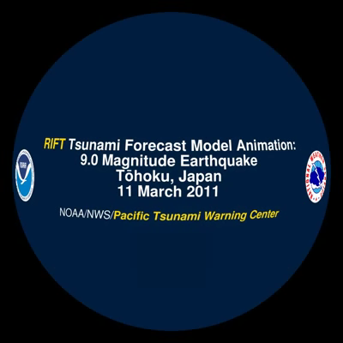
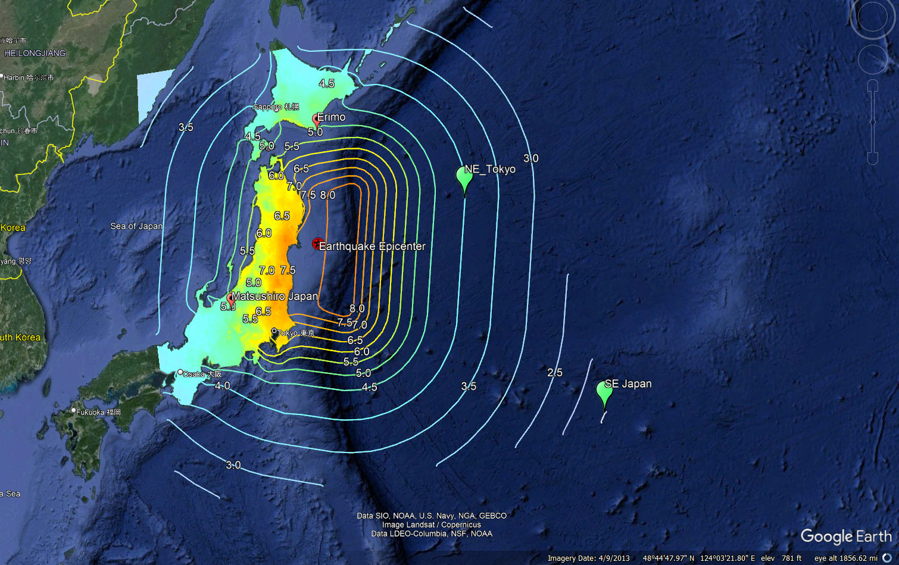
March 11, 2011 M9.1
Inundation 6 miles inland near Sendai
Lead to the Fukushima Nuclear Incident
Measured Wave Heights – 33ft (Coast of Japan)
Notes:
Wave Amplitude is related to ocean depth, deep waters mean lower waves, shallow = High .
Waves decay with distance , waves reflected both can intensify and dampen each other.
Really high frequency's may be from choppy waters , lower frequencies may be daily tides, middle frequencies give us an idea of each passing wave.

Slide 3
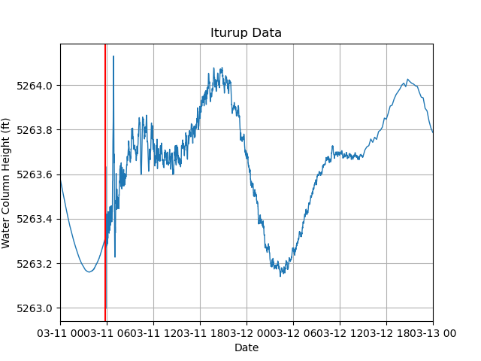
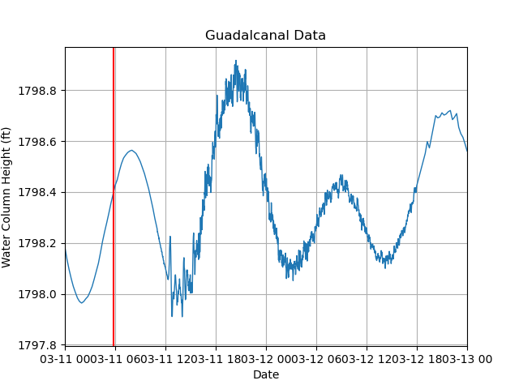
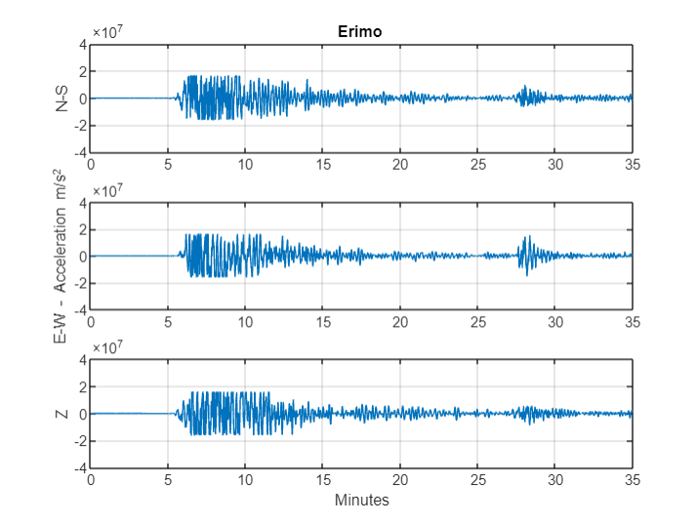
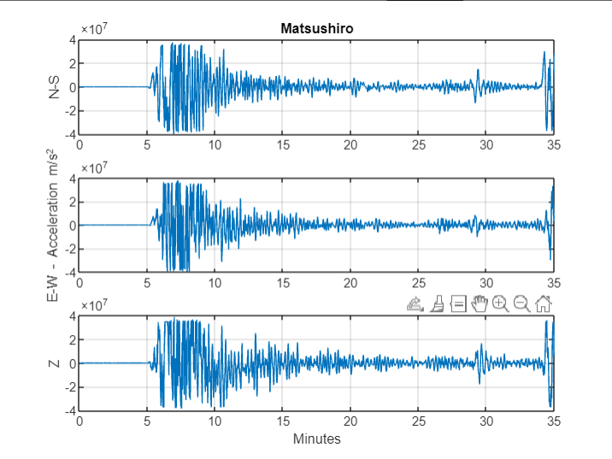
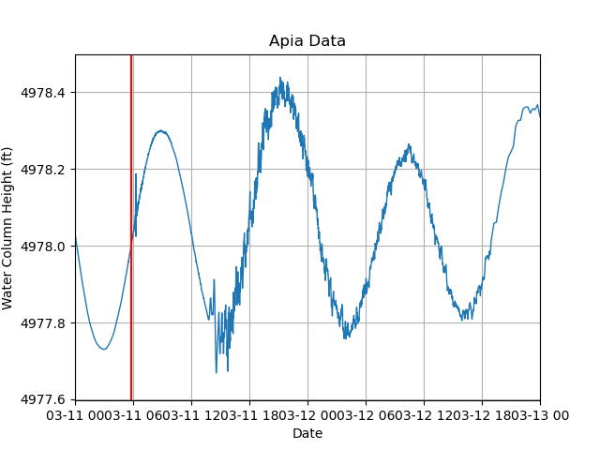
Data
SAGE IRISDMC – Seismograms - acceleration
NOAA NDBC – Buoys – water column height

Slide 4
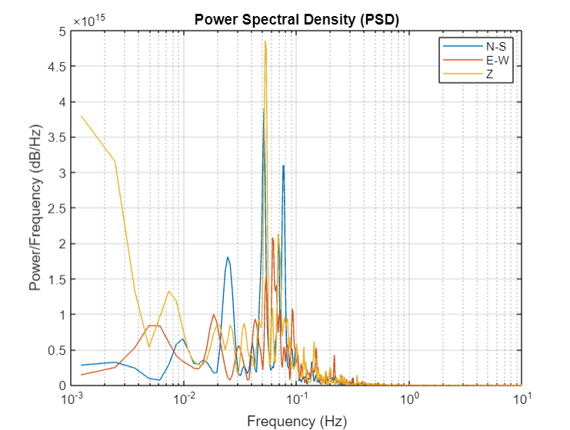
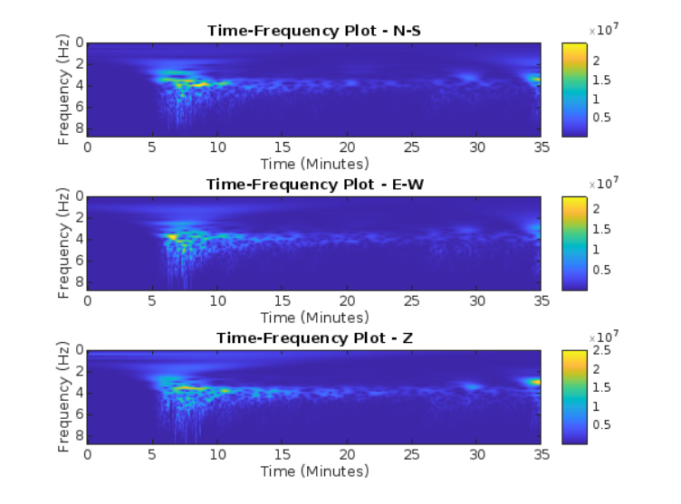
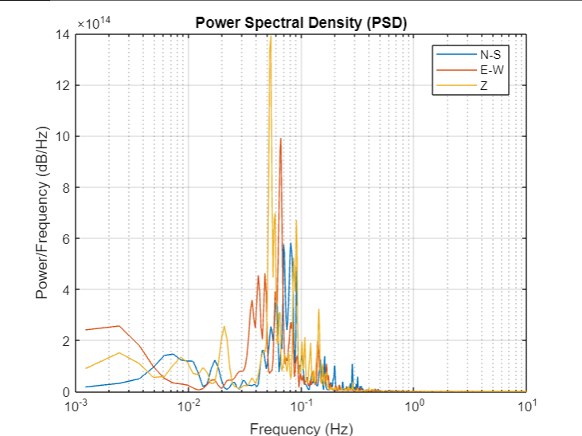
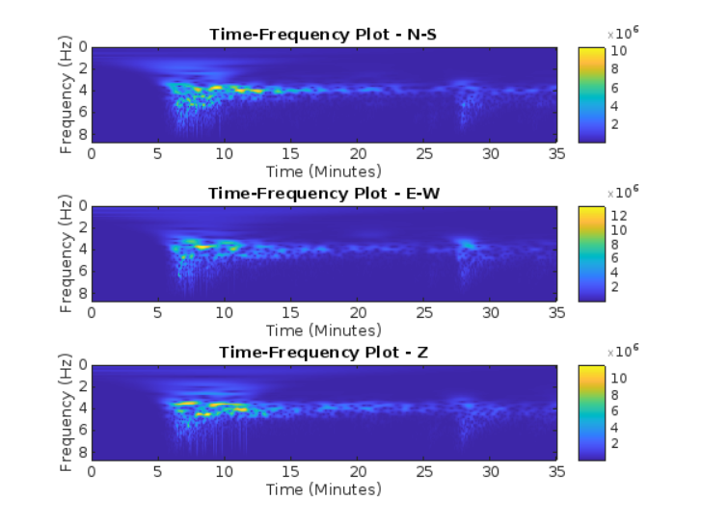
Matsushiro Japan

Slide 5
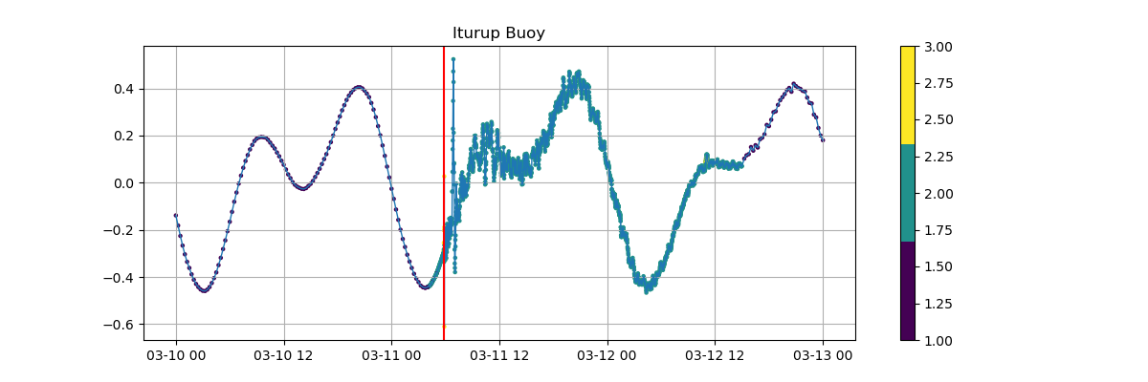
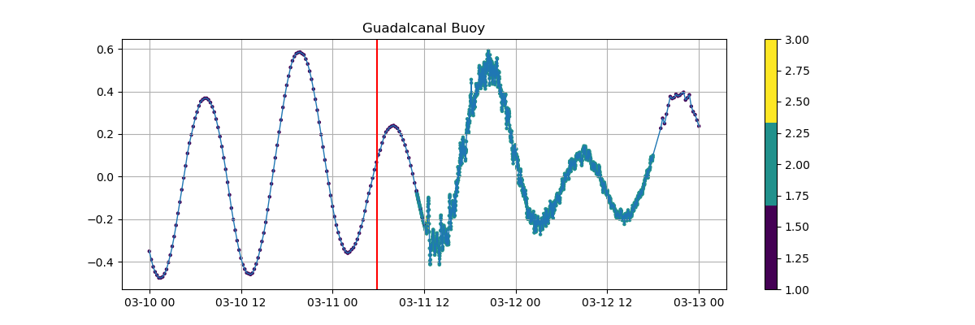
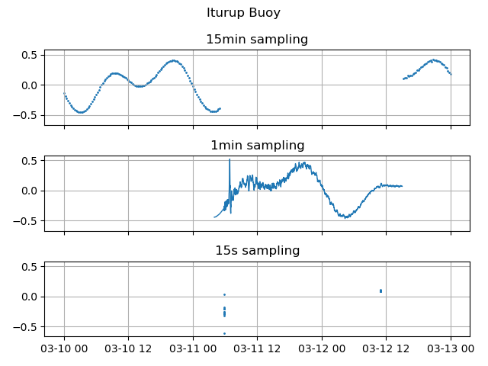
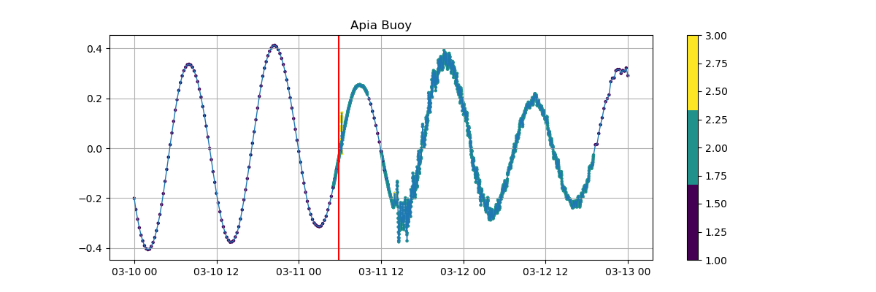
Sampling Rates
Tide buoys do not transmit signals at a consistent sampling rate
Data is at a frequency of 15 minutes, 1 minute, or 15 seconds

Slide 6
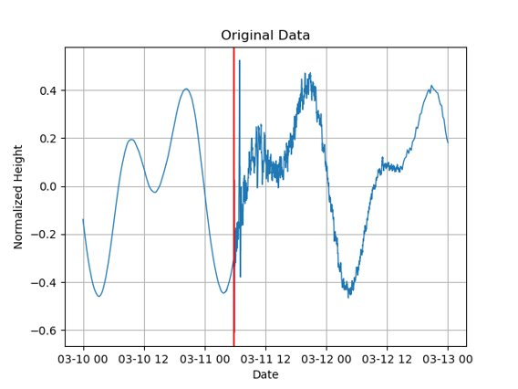
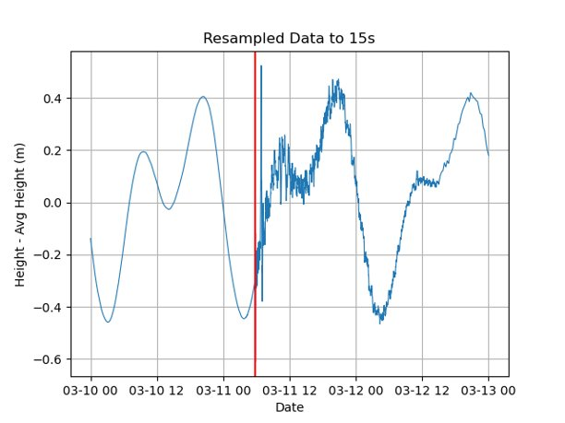
Resampling the Data
Resample the data to a consistent 15s sampling frequency using linear interpolation to fill missing values
Figures are Iturup Station Close to Epicenter

Slide 7
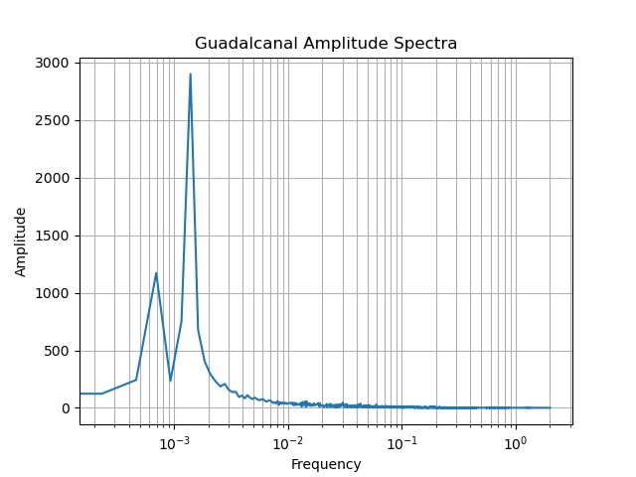
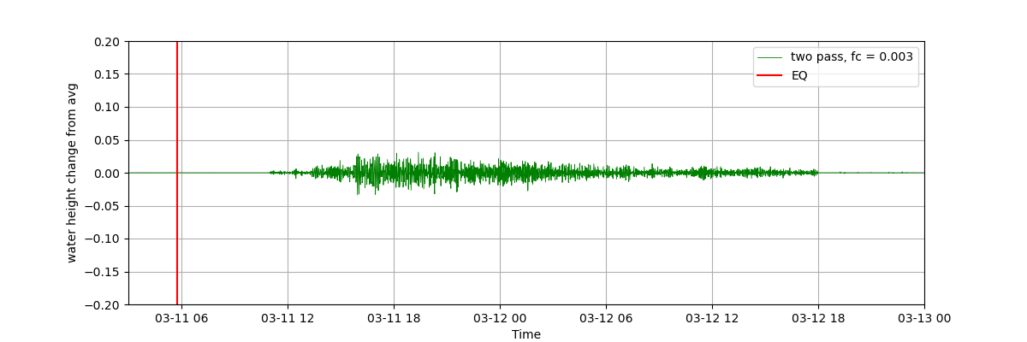
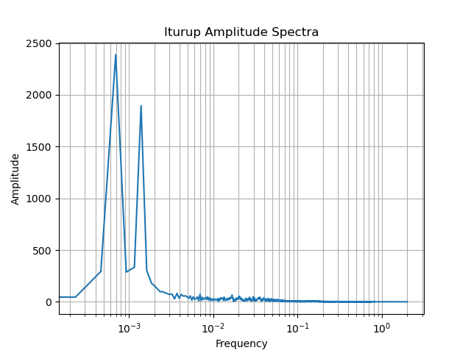
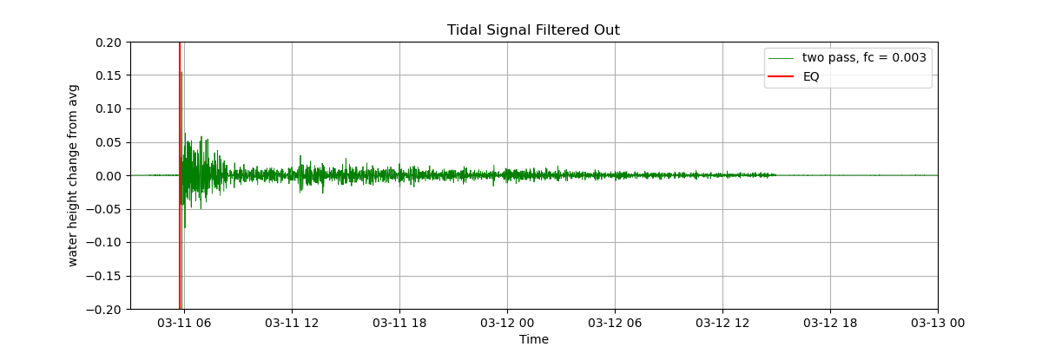
Filtering the Signal
High-pass Butterworth Filter
Cutoff frequency determined by looking at the Amplitude Spectrum – 0.003 Hz was pretty standard
Low Frequencies – Daily Tides

Slide 8
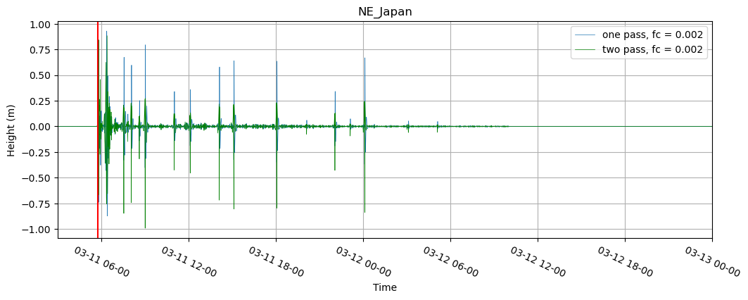
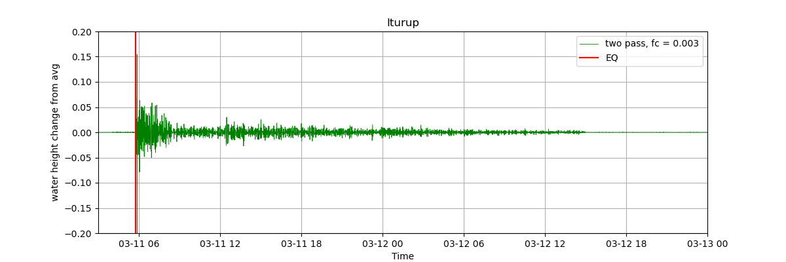
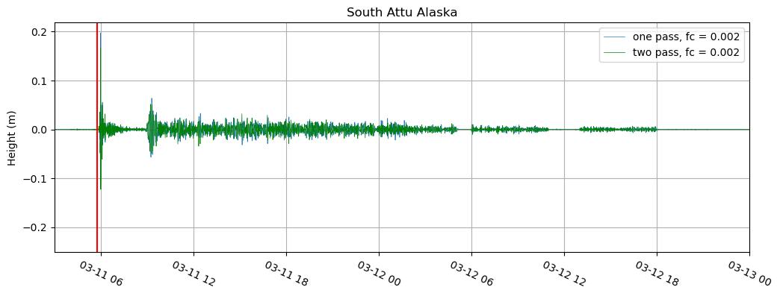
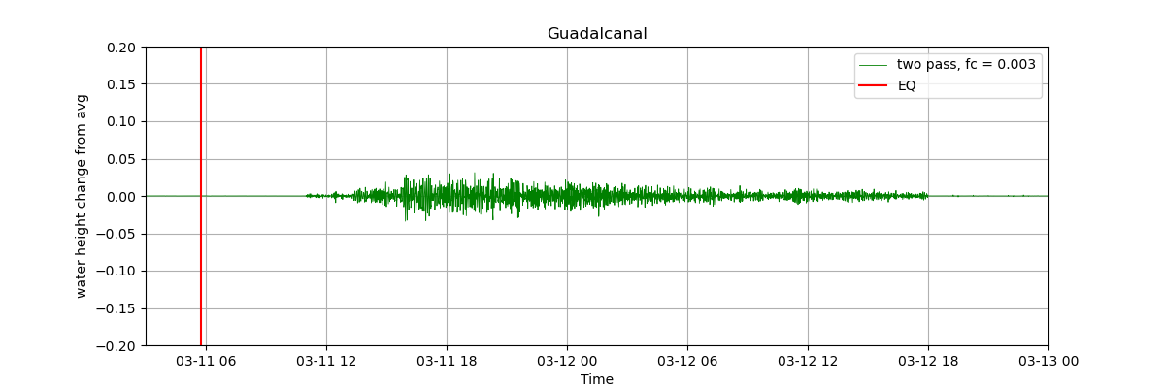
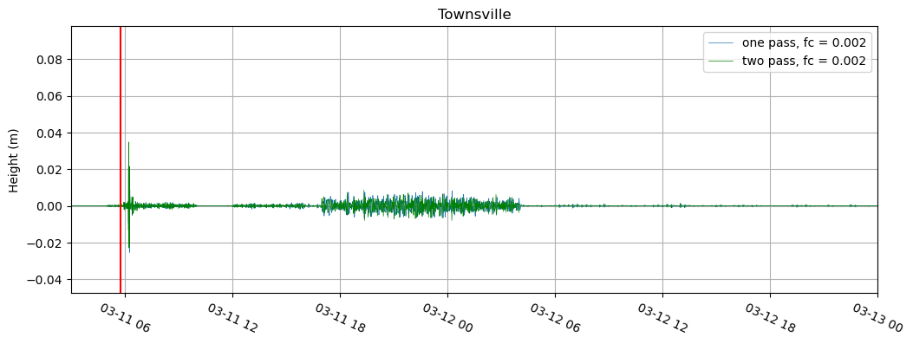
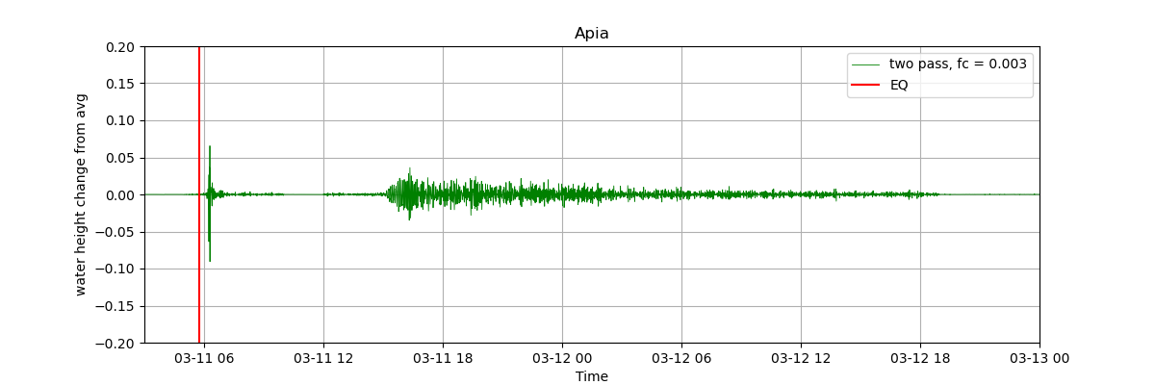

Slide 9
Sources
National Oceanic and Atmospheric Administration (n.d.). National Data Buoy Center. NOAA NDBC. Retrieved March 1, 2024, from https://www.ndbc.noaa.gov/obs.shtml
National Oceanic and Atmospheric Administration (n.d.). On This Day: 2011 Tohoku Earthquake and Tsunami. National Centers for Environmental Information. Retrieved March 6, 2024, from https://www.ncei.noaa.gov/news/day-2011-japan-earthquake-and-tsunami
SAGE Seismological Facility for the Advancement of Geoscience (n.d.). SAGE Wilber 3 Select Stations. Retrieved February 23, 2024, from https://ds.iris.edu/wilber3/find_stations/3279407
United States Geological Survey (n.d.). M 9.1 - 2011 Great Tohoku Earthquake, Japan. USGS Earthquake Hazards Program. Retrieved March 2, 2024, from https://earthquake.usgs.gov/earthquakes/eventpage/official20110311054624120_30/executive

